Slide 1

ANNAMACHARYA INSTITUTE OF TECHNOLOGY AND SCIENCES::TIRUPATI (AUTONOMOUS) Artificial Intelligence and Data Science A.Y.: 2025-2026 Implementation of Text-to-Image Generators in Designing Usability Interfaces for Web Page Construction
Under the Guidance of
Ms.K.Gangothri, MCA
Assistant Professor
Department of AI&DS
AITS, Tirupati
Head of the Department
Mrs.B.Rupa Devi Singh, M. Tech (PhD)
Associate Professor
Department of AI&DS
AITS, Tirupati
AI&DS-2 : Batch No- 11
22AK1A3057 NARAYANA VARA PRASAD REDDY Y
22AK1A3065 PRABHAS V
22AK1A3074 SALEEM BASHA SHAIK
22AK1A3092 VENKATA ASHISH RAJ K

Slide 2
Problem Statement
Creating images manually requires significant time, effort, and design expertise
Users without design skills face difficulty in creating visual content
Traditional design tools are often complex and time-consuming
Rapid generation of customized images is difficult using manual methods
There is a need for an automated text-to-image generation system

Slide 3
Objectives
Develop a text-to-image generation system
Use Stable Diffusion for image creation
Convert user text into meaningful images
Provide a simple and user-friendly interface
Support multiple image styles (Realistic, Iconic, Algerian)
Reduce manual effort and time

Slide 4
Proposed System
Uses pretrained Stable Diffusion v1.5 model
Generates images directly from text prompts
Supports multiple styles
(Realistic, Iconic, Algerian)
Provides fast image generation through web interface
Reduces manual design effort and time
Easily integrated using Django framework
Produces high-quality images automatically

Slide 5
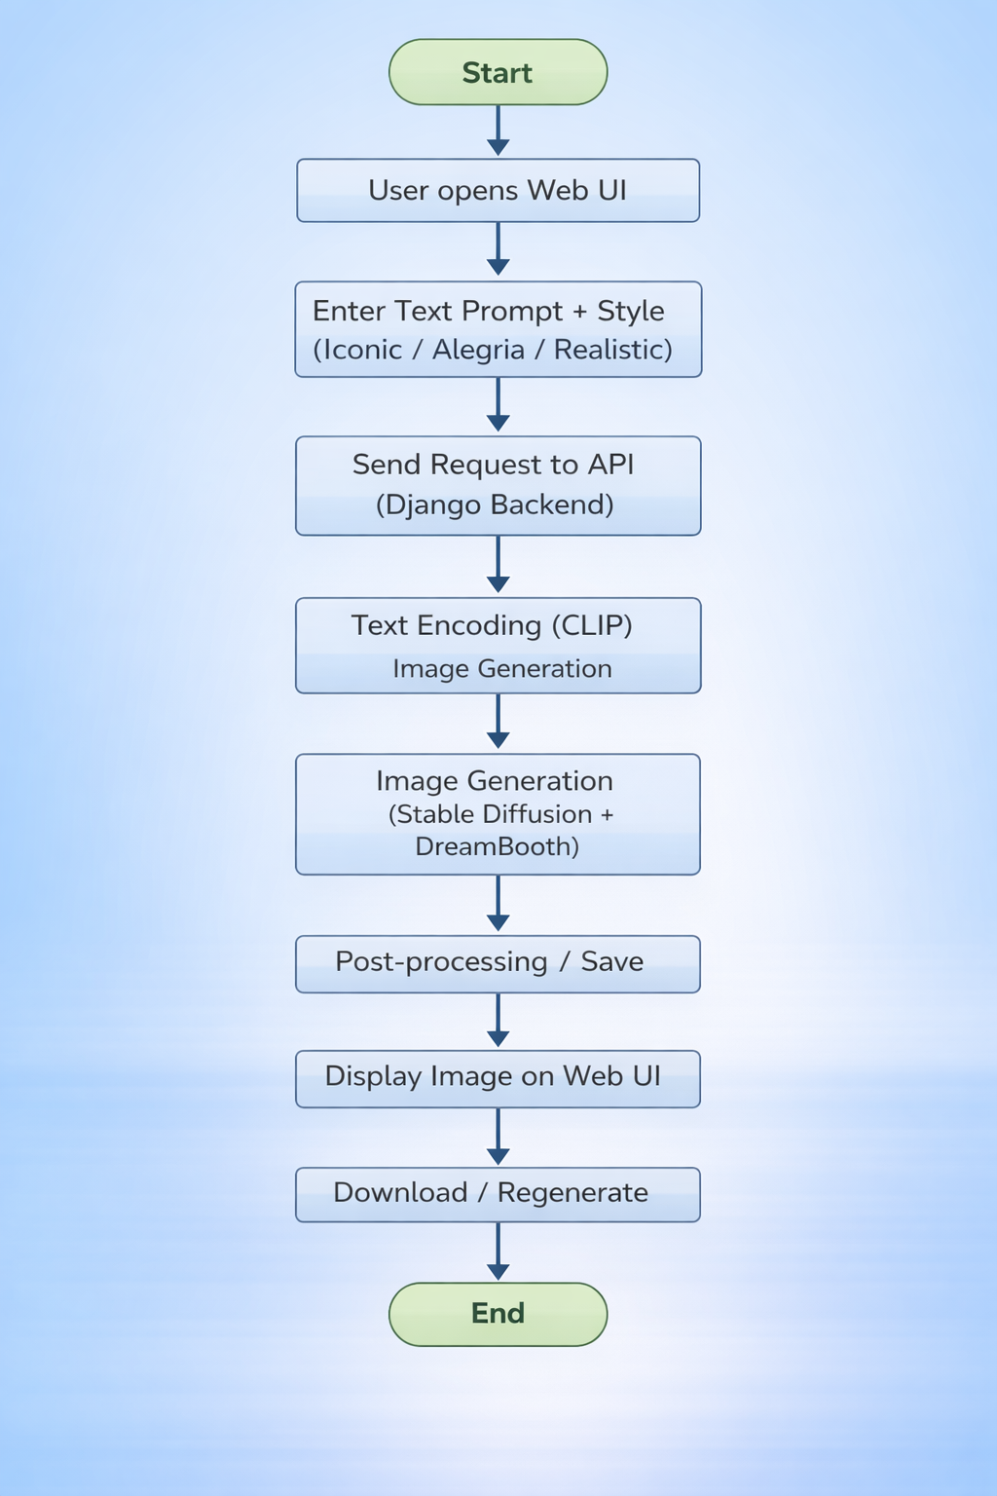
Integration Process
Integration Process
Workflow:
User opens the web application ⬇ Enter text prompt ⬇ Select image style (Iconic / Alegria / Realistic) ⬇ Submit prompt ⬇ Backend processes request ⬇ Stable Diffusion generates image ⬇ Generated image displayed on UI ⬇ User can download or regenerate image

Slide 6
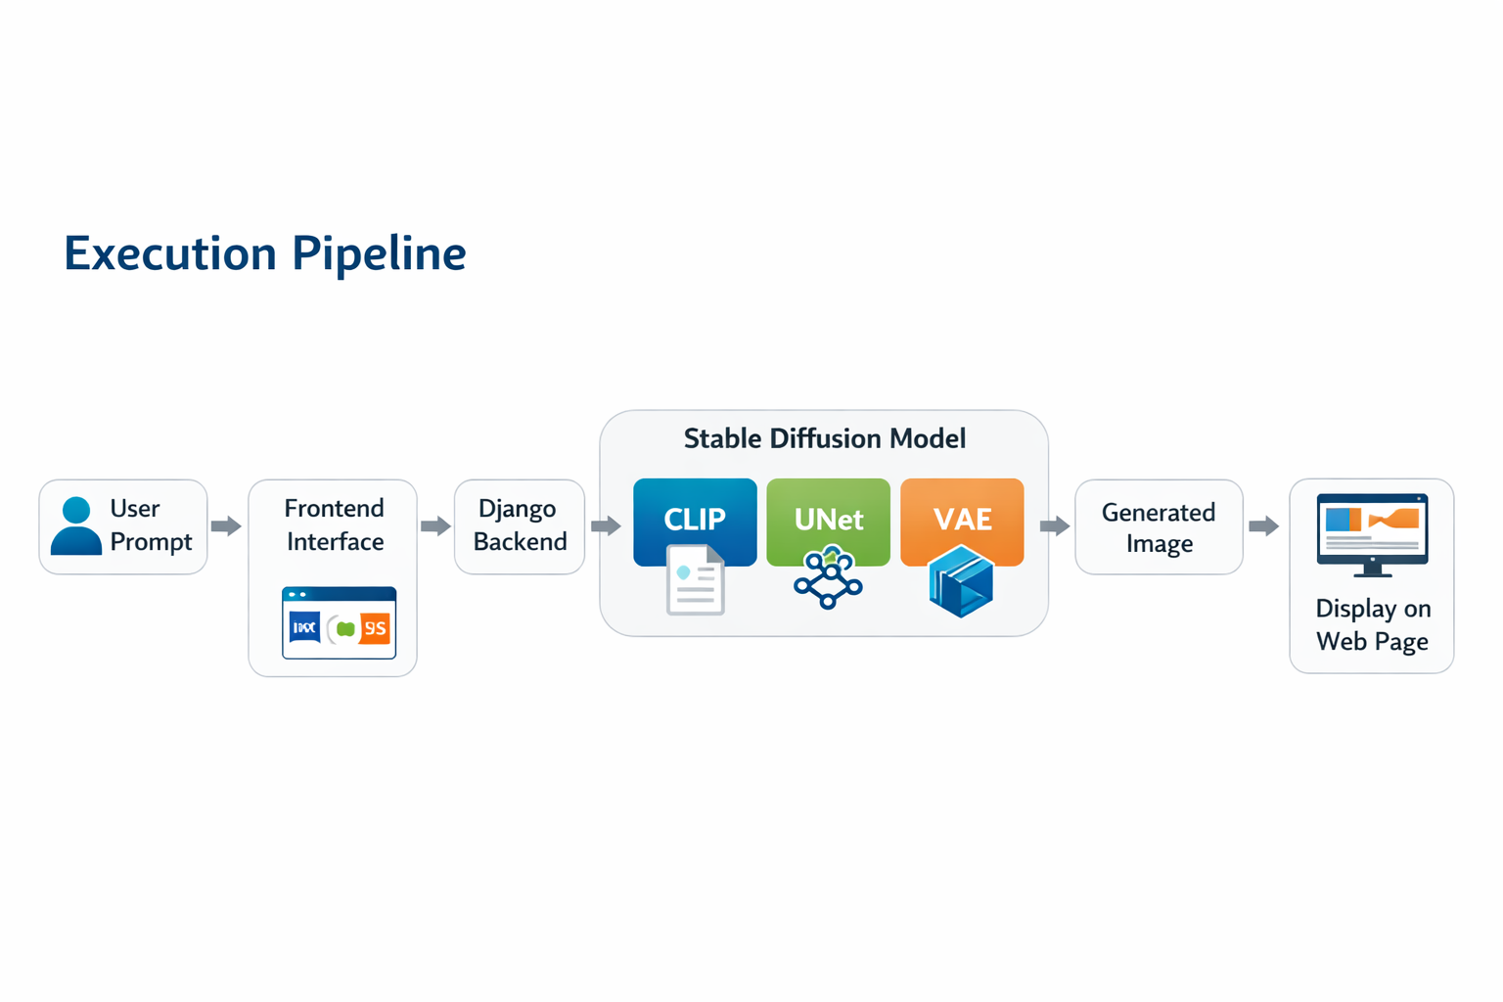

Slide 7
ALGORITHMS CONSIDERED
Stable Diffusion (Implemented Model)
Stable Diffusion is a deep learning–based generative model used for text-to-image generation. It converts natural language prompts into images using a diffusion process that transforms random noise into meaningful images. (Used version Stable Diffusion v1.5)
Core Components of the Model
1. CLIP Text Encoder(Contrastive Language–Image Pre-training)
Converts input text prompt into numerical embeddings
Provides semantic understanding of the prompt
2. UNet Diffusion Network
Core neural network of the diffusion model
Performs iterative denoising to generate image structure
3. Variational Autoencoder (VAE)
Converts latent representation into final RGB image
Enables efficient image generation in compressed latent space

Slide 8
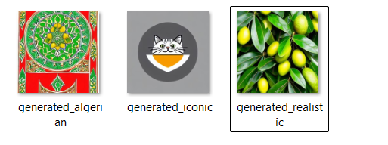
Performance Results
Performance Results:
The model successfully generated UI images from text prompts.
Generated images showed good relevance and visual quality
Image generation time was around 10 minutes per output.

Slide 9
CONCLUSION
Project Summary
Successfully developed a Text-to-Image Generation System using the Stable Diffusion model.
The system converts natural language prompts into meaningful images using diffusion-based generative AI.
Implemented a web-based interface using Django for user interaction and image visualization.
Key Achievements
Integrated Stable Diffusion with a Django web application.
Generated images that closely match the given text prompts.
Reduced the need for manual image design in usability interfaces.
Demonstrated a practical application of Generative AI in web development.
Final Outcome
The project demonstrates how diffusion-based generative models can automate image creation from text, improving efficiency and enabling new possibilities in UI development and creative applications.

Slide 10
FUTURE SCOPE
Possible Enhancements
Support for Additional Image Styles Extend the system to generate images in more artistic and design styles.
Advanced Prompt Engineering Improve prompt design techniques to generate more accurate and detailed images.
Real-Time Image Generation Optimize the system to generate images faster for real-time applications.
Cloud Deployment Deploy the system on cloud platforms to improve scalability and accessibility.
Multimodal Extensions Extend the system to support text-to-video or text-to-3D generation.

Slide 11
THANK YOU

